Slide 1
Lecturer:
Alex Ely Kossovsky
An alumnus of CUNY Hunter College
Applied Mathematics & Statistics Dept.

Slide 2
Mathematical Perspectives in the Emergence of Physics

Slide 3
Outline
The erroneous notions of ancient Greek astronomy.
Renaissance era discovery of physics.
The role of mathematics.
Kepler’s 3rd Law & Logarithms.
The rise and fall of Bodes’ Law.

Slide 4
Greek Hellenic Culture
776 BC - 146 AD

Slide 5
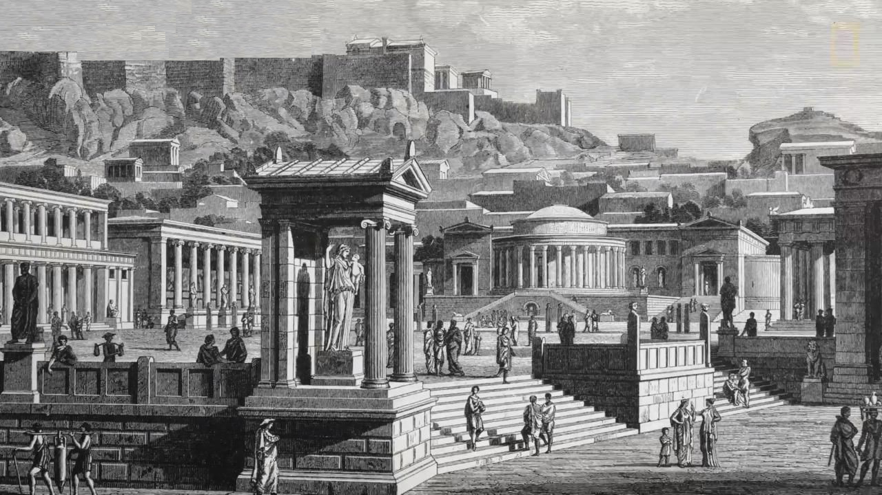
Athens, Greece

Slide 6
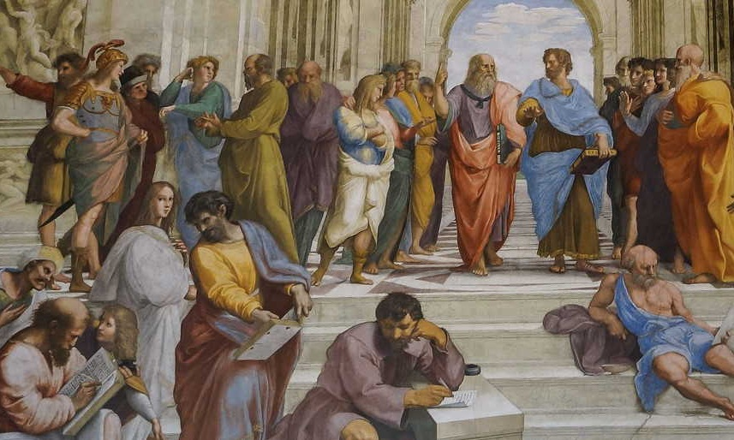
School of Athens (by Raphael)

Slide 7
Ancient Greece had a strong influence on matters
of astronomy, mathematics, and geometry.
But less so on science.

Slide 8
Euclid
Archimedes
Ptolemy
Hippocrates
Democritus

Slide 9
The Great Library of Alexandria in Egypt, was one of the largest and most significant libraries of the ancient world.
It had a research institution.
It had about 200,000 scrolls (books).

Slide 10
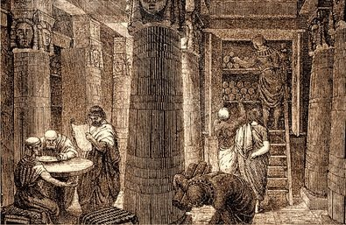
Library of Alexandria

Slide 11
Three erroneous ideas
of ancient Greece:

Slide 12
(I) Celestial Immutability
The heavenly bodies were considered to be eternally unchangeable.

Slide 13
(II) Celestial Perfection
Celestial objects were considered to be:
Perfect spherical shapes
Perfect circular orbits
Beautiful, without spots or blemishes

Slide 14
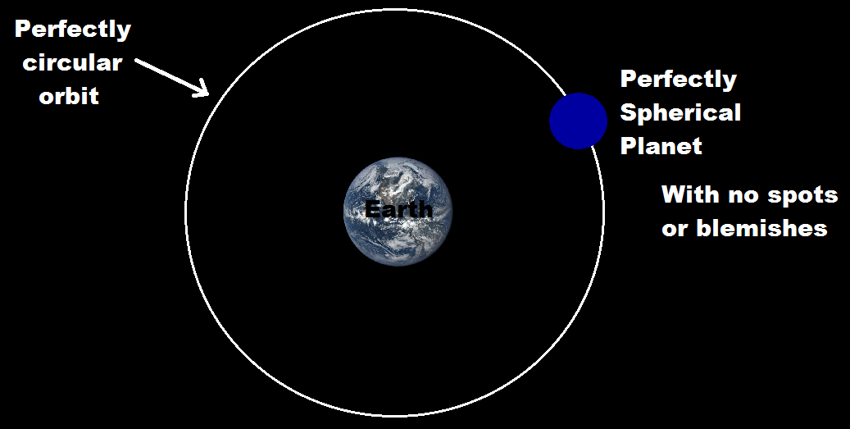

Slide 15
But the mathematical implications of physical law create odd and uneven orbits.
Such as Conic Sections:
ellipses, circles, parabolas, hyperbolas.

Slide 16
The Planets, the Sun, and the Moon are physical entities.
Hence
They undergo change.
They are not perfectly-looking.
They are not Greek Gods.

Slide 17
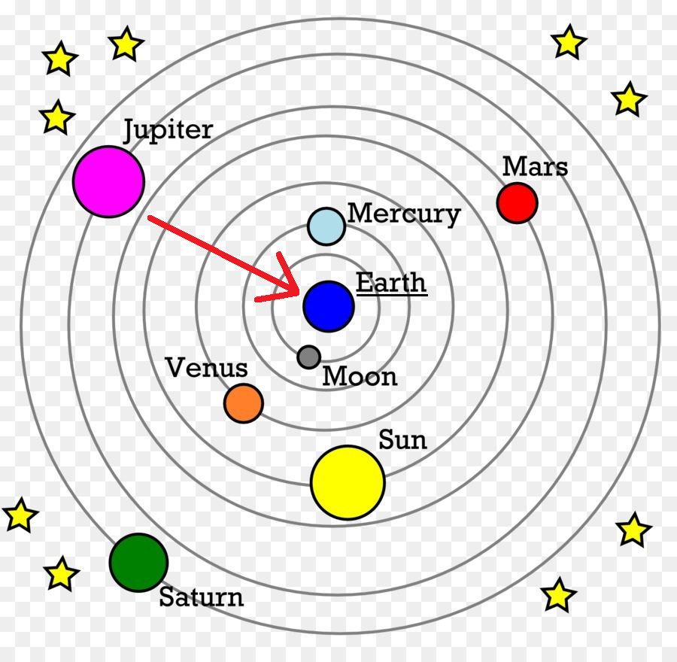
(III) The Geocentric Model

Slide 18
The geocentric model in astronomy was summarized by the Greek astronomer Ptolemy of Alexandria in his treatise ‘Almagest’.
It is based on the notion that the Planets and the Sun revolve around the Earth.

Slide 19
These 3 dogmas held back progress in science.
Humanity had to overcome this.
It overcame this about 2000 years later during the Renaissance era.

Slide 20
========================

Slide 21
The Renaissance
----------------------------------------

Slide 22
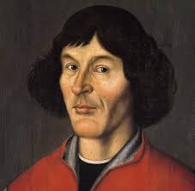
Nicolaus Copernicus (1473 – 1543)
The Heliocentric Revolution

Slide 23
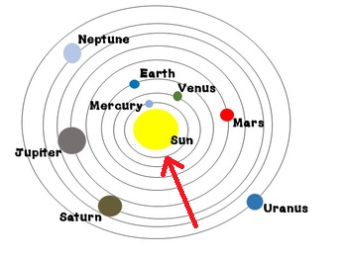
Heliocentric Model of Astronomy

Slide 24
The heliocentric Model hints at gravitational force of the sun acting on the planets!
The Sun holds the planets together, pulling them inwards.
It’s only a clue!

Slide 25
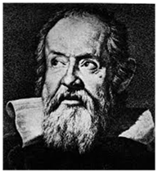
Galileo Galilei (1564 - 1642)
The Father of Science
Central figure in the Renaissance era transition from natural philosophy to modern science

Slide 26
Galileo’s generic contributions to physics and science:
Empiricism for philosophy of science, namely the Scientific Method. The rejection of highly abstract philosophical arguments about the world without experimental sensory data.
The adoption of Mathematics and Geometry as essential tools in science.

Slide 27
The 4 principle contributions of Galileo to the core concern of physics, namely to the Study of Motion:

Slide 28
Horizontal inertia.
Proper definition of acceleration as a = ∆Speed / ∆Time.
Vertical free fall acceleration is a constant and independent of the weight-mass.
The splitting of projectile motion into its inertia-like constant-speed horizontal component, and free-fall accelerating vertical component.

Slide 29
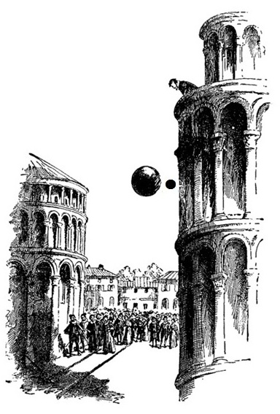
The dropping of two spheres from the Leaning Tower of Pisa

Slide 30
The heliocentric model was passionately supported by Galileo who risked his life defending it.

Slide 31
Galileo then gave the heliocentric model decisive confirmations with his telescopic observations of Jupiter's four moons and the phases of Venus.

Slide 32
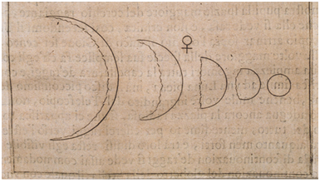
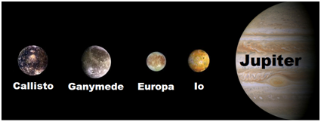
Phases of Venus
Jupiter's Four Moons

Slide 33
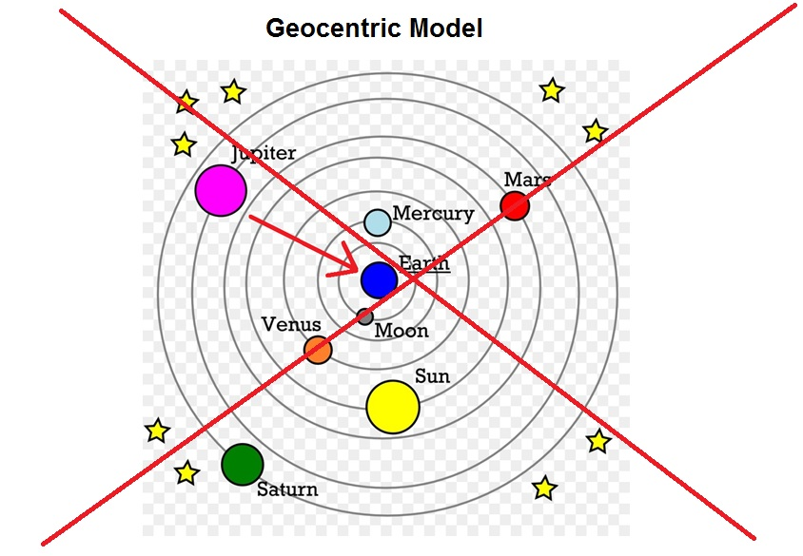

Slide 34
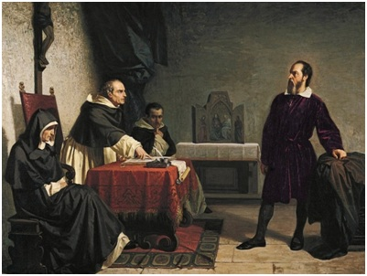
Galileo’s Trial – Rome 1633

Slide 35
And yet it moves!

Slide 36
LESSON TO HUMANITY:
You have jailed your first physicist.
You have condemned him to be surrounded by Inquisition soldiers for the rest of his life.
Free speech is essential !

Slide 37
LESSON TO HUMANITY:
‘Group Think’ is not conducive to healthy science.
Religion & Science are best left separated.

Slide 38
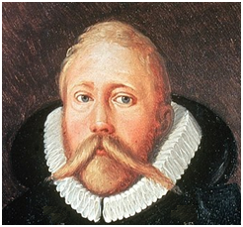
Tycho Brahe (1546-1601)
The Meticulous Celestial Recorder
Swedish-Danish astronomer Known for his highly accurate and comprehensive astronomical observations regarding the planets’ movements.

Slide 39
King Frederick II of Denmark offered Tycho the use of the island of Hven for the purpose of conducting astronomical observations.

Slide 40
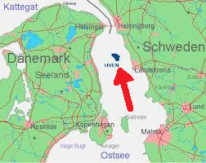
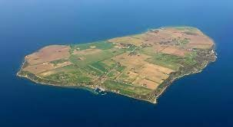
Hven

Slide 41
Tycho built an observatory in Hven he called Uraniborg in 1576, and made highly precise naked-eye observations.

Slide 42
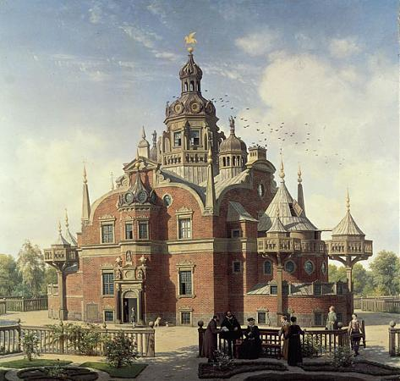
Tycho’s Uraniborg castle.

Slide 43
Tycho collected an astounding amount of astronomical data, writing down the location of stars and planets in the sky and the associated time of observations.

Slide 44
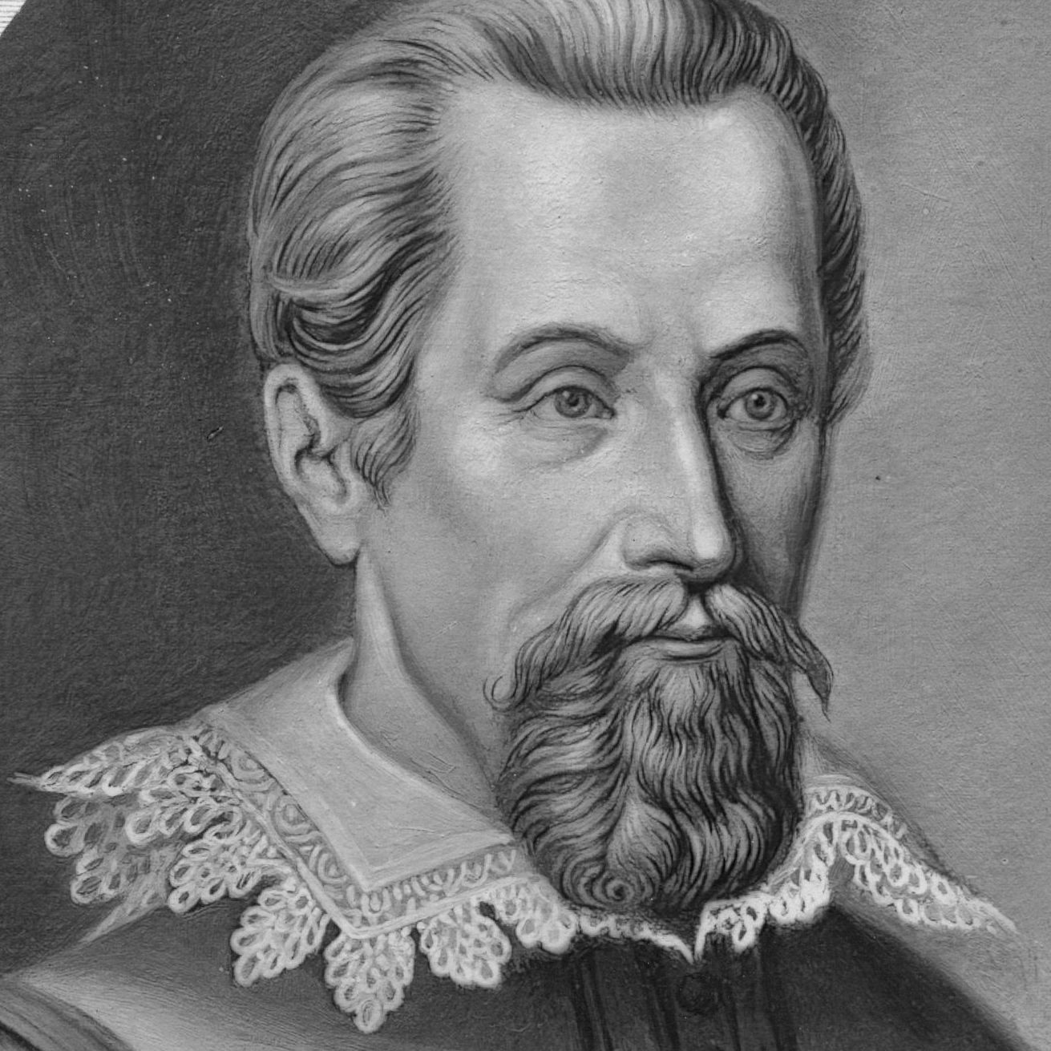
Johannes Kepler (1571-1630)
Considered the First Data Analyst

Slide 45
In 1599 Tycho was warmly invited to Prague by Rudolf II, Holy Roman Emperor, to build his second observatory in a castle near Prague.

Slide 46
As soon as Tycho settled in Prague, he invited Johannes Kepler of Germany who came there in February 1600.
Tycho needed an assistant, someone with mathematical talents and a good knowledge in astronomy to work on his data.

Slide 47
The relationship between Tycho and Kepler was often tense and conflicted, and they had several angry exchanges, arguments, and disagreements.
They finally came to an agreement about permanent position, and Kepler came to settle in Prague in 1600 and began working with some of Tycho’s data.

Slide 48
Tycho refused to give Kepler enough data.
Tycho did not trust Kepler with all his data.
Kepler had access only to very limited data.
Kepler could not discover anything.
Science could not progress.

Slide 49
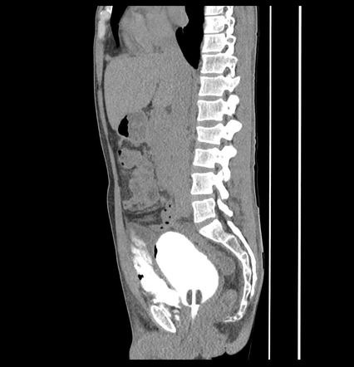
Fortunately for science...Tycho suddenly died (aged 54).
His death was probably caused by burst bladder.
Tycho Brahe’s burst bladder

Slide 50
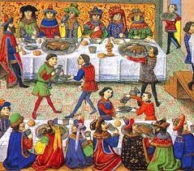
Tycho attended a feast in Prague with some honorable and important guests, and had refused to leave the feast to relieve himself in the bathroom because it would have been impolite.
After he returned home, he was no longer able to urinate almost. He died within 11 days.

Slide 51
So, in 1601, Tycho Brahe, gravely ill and on his deathbed, hands over to Kepler the most accurate planetary data in history, the entire data!

Slide 52
Now science can progress…

Slide 53
Kepler then formulates his 3 planetary laws over the following years after tedious calculations and persistent search for patterns in the data.

Slide 54
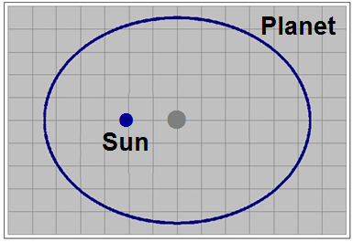
Kepler’s 1st Law
The orbit of a planet is an ellipse with the Sun at one focal point away from the center.
So it’s not the perfect and symmetrical Greek Circle !

Slide 55
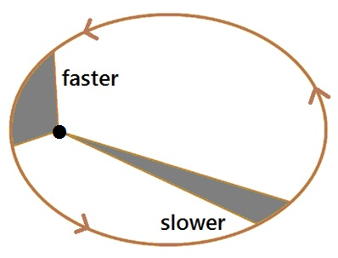
Kepler’s 2nd Law
Each planet speeds up while its orbit is near the Sun and slows down while its orbit is farther away.
Equal areas during equal intervals of time.

Slide 56
Kepler’s 3rd Law
The square of the Time for one full orbit (T²) is equal or rather proportional to the cube of its Distance from the Sun (D³).

Slide 57
The value of K is a constant,
depending on scales and units in use.

Slide 58
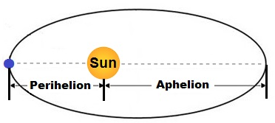
Distance D is the average of maximum and minimum displacement from the Sun.
D = (Perihelion + Aphelion) / 2

Slide 59
========================

Slide 60
Kepler’s 3rd Law - Statistically
------------------------------------------------------

Slide 61
Let us examine how Kepler might have discovered his 3rd law:

Slide 62
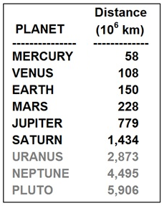
Facts Planets’ distance from the Sun (million kilometers)

Slide 63
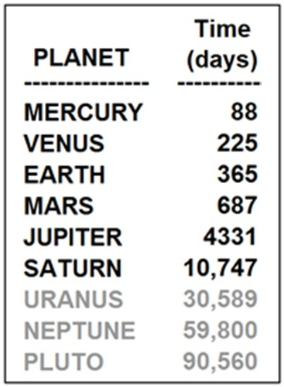
Facts Planets’ orbital time period (days)

Slide 64
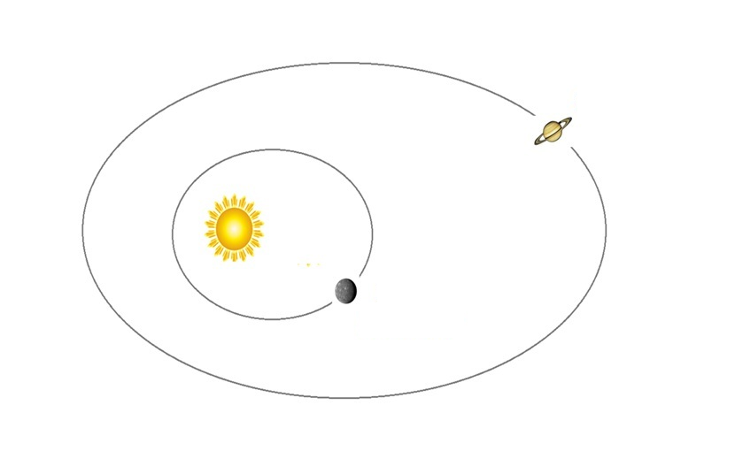

Slide 65
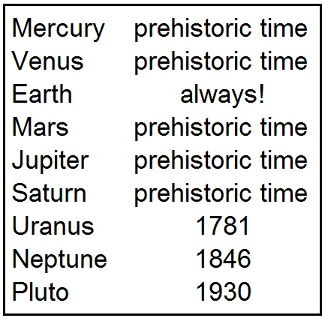
Discovery time

Slide 66
So Uranus, Neptune, Pluto were still unknown to Kepler.
His analysis would rely on data from the 6 planets:
Mercury
Venus
Earth
Mars
Jupiter
Saturn

Slide 67
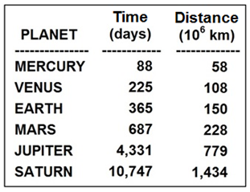
The data available to Kepler

Slide 68
It is incredible that this small data set having merely 6 data points could constitute the seed of modern physics!
Well, it takes a mathematician/scientist like Kepler to bring this into fruition.

Slide 69
Kepler could not have utilized charts or graphs in order to better visualize the data.
Because the graph simply did not exist yet!
René Descartes would invent the concept of the graph a few years later.

Slide 70
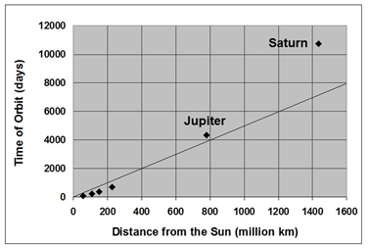
Chart not available to Kepler
Time vs. Distance
Exploding upward

Slide 71
Luckily Kepler did not know anything about:
Simple Linear Regression
Generalized linear model
Polynomial regression
Discrete choice
Logistic regression
Multinomial logit
Ordered logit
Poisson Multilevel model
Fixed effects
Random effects
Nonlinear regression
Nonparametric
Semiparametric

Slide 72
Don’t do it Kepler !
Don’t do Regression Analysis please !
Don’t try to get parameters and stop there !
Instead look for more profound and more exact results !

Slide 73
Let us attempt to transform the 2 variables so as to obtain a Linear Relationship:

Slide 74
Why? Because Linear Relationship would imply some PREDICTABILITY.

Slide 75
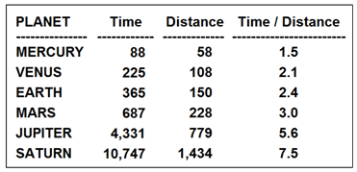
Let’s try simple Time/Distance ratios:
Ratios are increasing

Slide 76
Ratios are not steady.
Time is growing faster than the Distance.
Time is stronger than Distance, and we need to counter this trend.
So let’s help Distance grow a bit faster by squaring it.

Slide 77
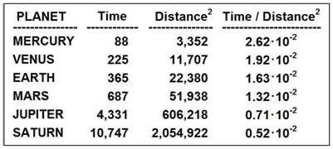
Let’s try Time/Dist² ratios:
Ratios are decreasing

Slide 78
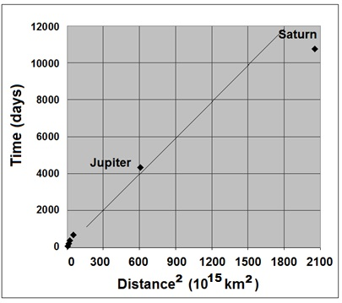
Time vs. Distance²
Trending downward

Slide 79
It’s not working.
We have exaggerated.
We have permitted Distance grow way too fast.
Distance is overtaking Time now.
Nothing is steady. Ratios decrease.
So let’s try giving both of them powers, but in a way that helps Distance more relative to Time. For example Distance³ and Time².

Slide 80
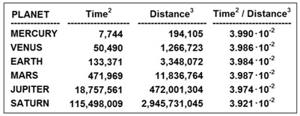
Let’s try Time²/Dist³ ratios:
Ratios are very steady! ≈ 3.980*10⁻²

Slide 81
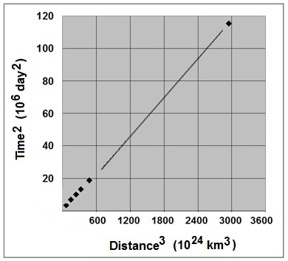
Time² vs. Distance³
Nearly perfectly linear!

Slide 82
Eureka!
Power-Law Relationship!

Slide 83
========================

Slide 84
Kepler’s 3rd Law - Logarithmically
--------------------------------------------------------------

Slide 85
But the supposed process of discovery outlined above was not the way Kepler actually worked it out.

Slide 86
Kepler was inspired by Pythagoras who was the first to make the connection between mathematics and music in the 6th century BC in ancient Greece.
This would lead to the 3rd Law via Logarithms!

Slide 87
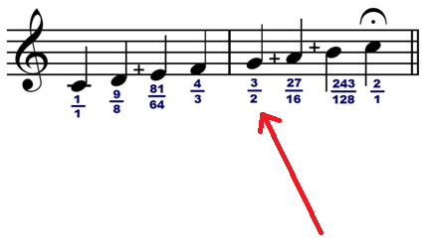
Pythagorean Tuning

Slide 88
Pythagorean Tuning is a system of musical tuning in which the frequency ratios of all intervals are based on the ratio 3/2 plus some adjustments up or down using the factors 2/1, 1/2, and 2/3.

Slide 89
For the ancient Greeks, integral whole numbers represent beauty, perfection, and harmony of sound as well (music).

Slide 90
Kepler in search of Harmony of the Planets

Slide 91
Deprived of Statistical Data Analysis such as Linear Regression.
Unable to draw a chart.

Slide 92
Kepler have been decisively aided by the recent mathematical invention of Logarithms just a few years before his discovery of the third law.

Slide 93
John Napier of Scotland in 1614 published a book regarding the invention of logarithms.
Joost Bürgi of Switzerland also published his own work on logarithms around that time.

Slide 94
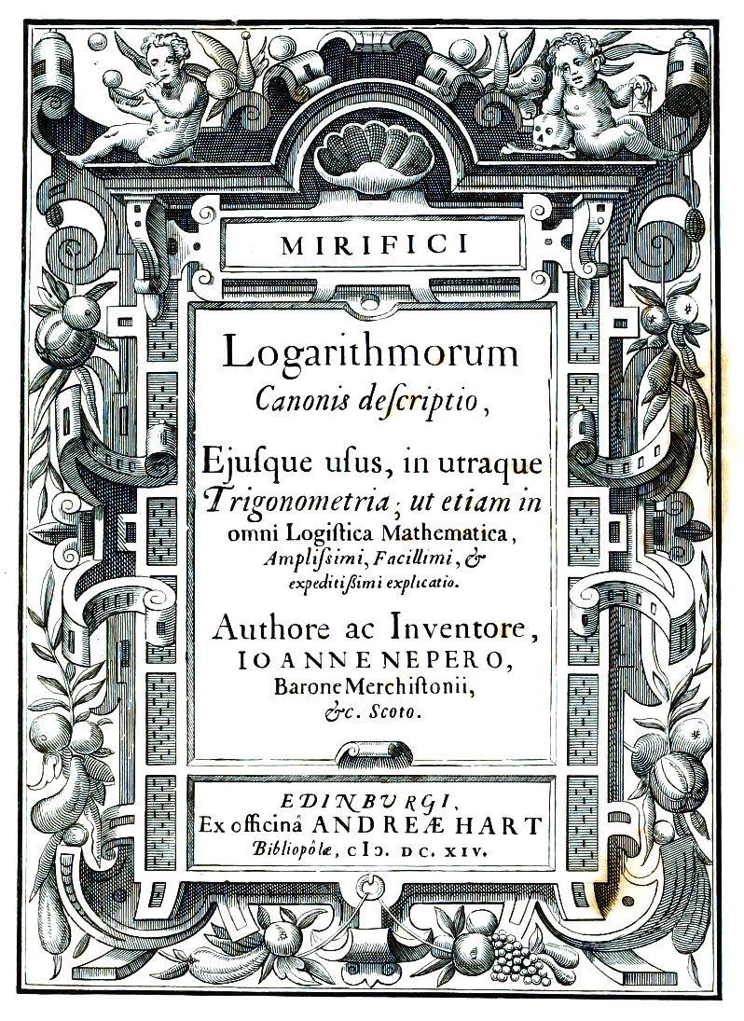

Slide 95
Kepler was well-aware of Bürgi & Napier Logarithms discovery, and he often communicated with them.

Slide 96
An alternative form of Kepler’s 3rd Law:
T² = K*D³
Let us apply logarithm to both sides:
Log(T²) = Log(K*D³)
2*Log(T) = Log(K) + 3*Log(D)
Log(Time) = Log(K)/2 + (3/2)*Log(Distance)

Slide 97
Hence, Kepler's 3rd Law asserts that the Log-transformed data has a simple linear relationship on the scatter plot of Log(Time) as a function of Log(Distance) with a slope value of 3/2.

Slide 98
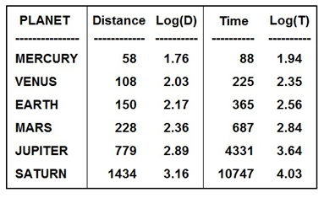
Somehow, Kepler is able to calculate the ‘slope’ for the Log-transformed data of the 6 known planets:

Slide 99
Kepler calculates ratios (slopes) of the Log-transformed planetary data for any two generic planets A and B:
Log(T_{A}) = Log(K)/2 + (3/2)*Log(D_{A})
Log(T_{B}) = Log(K)/2 + (3/2)*Log(D_{B})
Subtracting the 2nd equation from the 1st equation, we get:
Log(T_{A}) – Log(T_{B}) = (3/2)*[Log(D_{A}) – Log(D_{B})]
Log(T_{A}) – Log(T_{B}) ΔY
------------------------- = ------ = Slope = 3/2
Log(D_{A}) – Log(D_{B}) ΔX

Slide 100
So, for any two planets A and B:
Log(T_{A}) – Log(T_{B})
------------------------- = 3/2
Log(D_{A}) – Log(D_{B})

Slide 101
So, for any two planets A and B:
∆ Log(Time)
---------------------- = 3/2
∆ Log(Distance)

Slide 102
It’s that simple!

Slide 103
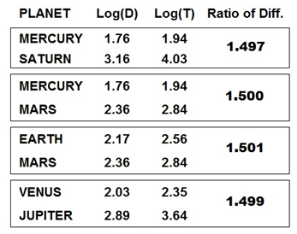
For example:

Slide 104
In the modern era, using the chart for the Log-transformed data, all this is quite straightforward:

Slide 105
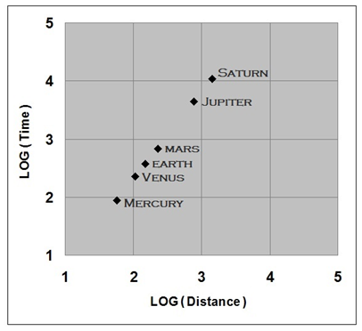
Linearity is confirmed! Slope is ≈ 3/2!

Slide 106
Kepler’s Postmortem Triumph!
The Entire Solar System Logarithmic Chart:

Slide 107
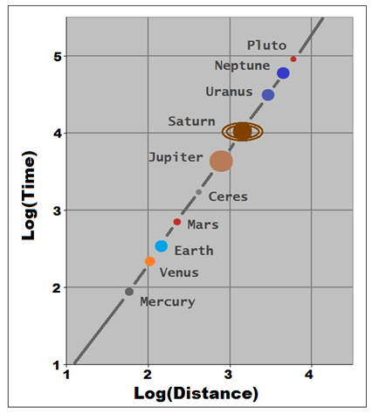

Slide 108
And this is so
regardless of units and scales in use!
This is scale-invariant law!
Always yielding that 3/2 slope!

Slide 109
It’s not music!

Slide 110
The planets are not related to music!

Slide 111
The mathematics of the physics here just happened to lead to this 3/2 ratio as the slope.

Slide 112
========================

Slide 113
Logarithms and Calculations
-----------------------------------------------------

Slide 114
In addition:
Napier and Bürgi came on the scene with the invention of the Logarithms just when Kepler was deeply immersed in endless and tedious arithmetical calculations.

Slide 115
To Kepler, the discovery of Logarithms was a timely gift.
Logarithms speeded up and eased arithmetic calculations.
Kepler greatly detested doing those endless calculations.

Slide 116
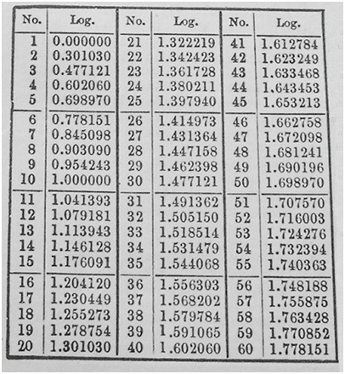
Logarithmic books and manuals

Slide 117
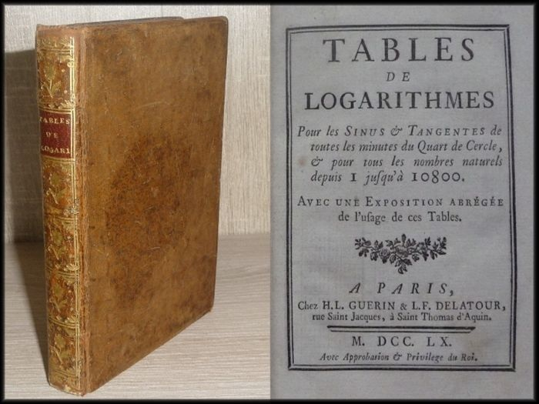

Slide 118
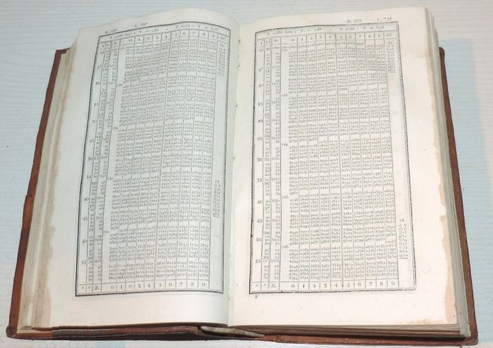

Slide 119
Typical Logarithmic Books have been published for over three centuries.
Until the advent of the electronic calculator and the computer.
They aid in the calculations of multiplications and divisions.

Slide 120
Focusing on the Logarithms of the refined set of numbers from say 1.00000 to 9.99999, in small incremental steps of 0.00001.

Slide 121
These 2 logarithmic rules
LOG(NxM) = LOG(N) + LOG(M)
LOG(N/M) = LOG(N) – LOG(M)
are the key to the application of logarithms in arithmetical calculations.
They allow the conversion of difficult
multiplications & divisions into simple
additions & subtractions.

Slide 122
As an arithmetical example, a division calculated via logarithms, such as:

Slide 123
First , Kepler considers its logarithmic value:
LOG₁₀(567525/329) =
LOG₁₀(567525) – LOG₁₀(329) =
LOG₁₀(100000x5.67525) – LOG₁₀(100x3.29) =
LOG₁₀(100000) + LOG₁₀(5.67525)
– LOG₁₀(100) – LOG₁₀(3.29)

Slide 124
Let us easily evaluate these 4 terms:
LOG₁₀(100000) = 5
LOG₁₀(100) = 2
And looking up the logarithmic table:
LOG₁₀(5.67525) = 0.753985
LOG₁₀(3.29) = 0.517196

Slide 125
Hence, the last 4 terms are reduced to:
LOG₁₀(100000) + LOG₁₀(5.67525)
– LOG₁₀(100) – LOG₁₀(3.29) =
5 + 0.753985 – 2 – 0.517196 =
5 – 2 + 0.753985 – 0.517196 =
3 + 0.236789 =
3.236789

Slide 126
So that: LOG₁₀(567525/329) = 3.236789
Namely: LOG₁₀(Answer) = 3.236789
Now Kepler could easily look up the logarithmic table and notice that:
LOG₁₀(1.725) = 0.236789
Therefore:
LOG₁₀(1.725) + LOG₁₀(1000) = 0.236789 + 3
LOG₁₀(1.725x1000) = 3.236789
LOG₁₀(1725) = 3.236789
Answer = 1725

Slide 128
========================

Slide 129
The Implication of Kepler 3rd Law to the Speed of the Planets --------------------------------------------

Slide 130
How fast do the planets move? (according to Kepler’s 3rd Law)

Slide 131
First, let us notice that:

Slide 132
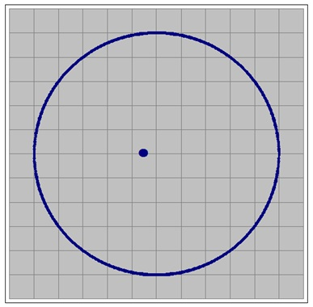
The elliptical orbit of Mars looks almost like a circle!

Slide 133
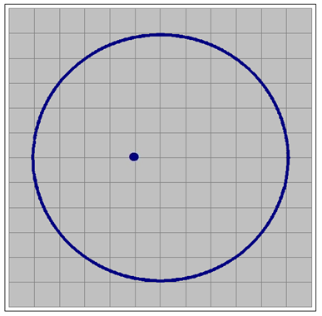
Even the highly eccentric elliptical orbit of Mercury looks almost like a circle!

Slide 134
But the Sun is not at the center of the orbit !

Slide 135
Therefore, we can approximate the circumference of the ellipse as the circumference of the circle, namely:
Circumference ≈ 2πR
Notation: Radius = Distance
Hence:
Circumference ≈ 2πD

Slide 136
Solving for T in the 3rd Law T² = KD³
We take √ on both sides
T = √(KD³)
T = √(K)√(D³)
T = √(K)√(D²D¹)
T = √(K)√(D²)√(D¹)
Time = √KD√D

Slide 137
Speed ≡ [Distance] / [Time]
Speed = [Circumference] / [Time]
Speed = [2πD] / [√KD√D]
D cancels out in the numerator and the denominator only once, hence:

Slide 138
Namely:
Speed is inversely proportional to the (square root of the) distance!

Slide 139
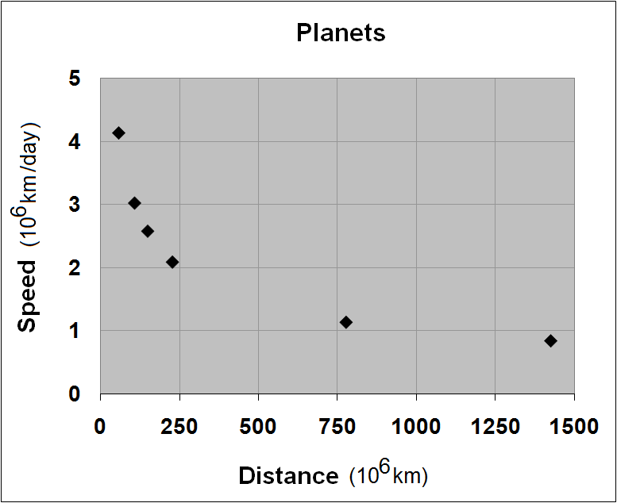

Slide 140
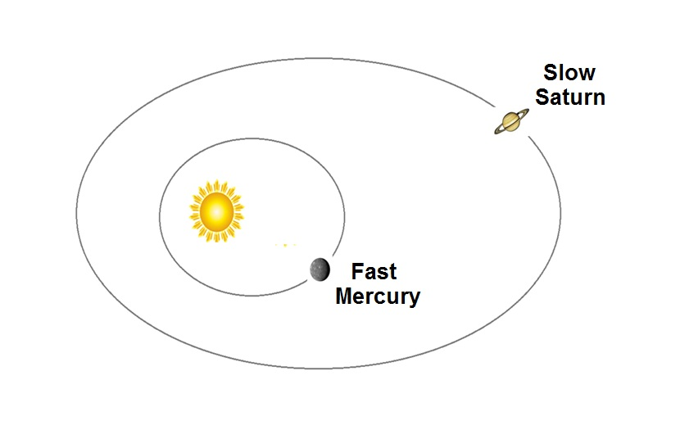

Slide 141
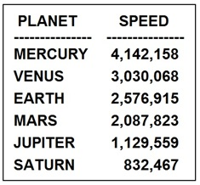
The Speed of the Planets
Kilometer/Day

Slide 142
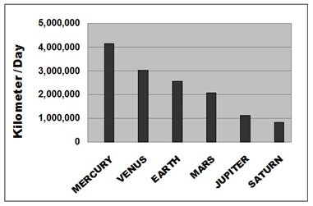
The Speed of the Planets

Slide 143
The inner planets Mercury and Venus near the Sun orbit very fast.
The outer planets Jupiter and Saturn far from the Sun orbit slowly.

Slide 144
Mercury and Venus are closer to the Sun and thus the effect of gravity is more pronounced.
Jupiter and Saturn are farther away from the Sun and thus the effect of gravity is less pronounced.

Slide 145
This hints that if the gravitational force is real, then it is correlated with closeness to the Sun!
Moreover, young Newton could get a hint that such a force is inversely proportional to the square of the distance:
FORCE_{GRAVITY} ~ 1/Distance²

Slide 146
Kepler’s Gravitational View
Kepler is the first thinker to hint at universal gravitation.
Significantly, Kepler proclaimed a philosophical-mechanical point of view of the Solar System that attributed to the Sun a ‘motricem animam’ (‘moving soul’), which causes the motion of planets.
Kepler speculated that the Sun is the source of the planets’ motion. This was a direct hint for Newton!

Slide 147
========================

Slide 148
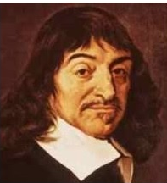
René Descartes (1596 – 1650)

Slide 149
The Cartesian Coordinate System was invented by René Descartes who published the idea later in 1637.

Slide 150
Humanity before Descartes was not aware of the horizontal and vertical graph system, nor of analytical geometry.

Slide 151
Crucially, this facilitated soon afterwards Isaac Newton formulation of Calculus, which in turned facilitated the formulation of physics based on Calculus.

Slide 152
Analytical Geometry
X² + Y² = 4 Circle
X²/16 + Y²/9 = 1 Ellipse
Y = 5X – 2 Line
Y = X² + 8 Parabola

Slide 153
========================

Slide 154
Isaac Newton (1642 - 1727)

Slide 155
Galileo’s Terrestrial Experiments
Kepler’s Celestial Data Analysis
Newton’s Grand Synthesis

Slide 156
Galileo’s Terrestrial Experiments
Projectile Motion
Horizontal inertia
Vertical acceleration (regardless of mass)
Earth (gravity) is not suspected as a cause of vertical acceleration – so Galileo is puzzled !

Slide 157
Kepler’s Celestial Data Analysis
Differentiated speed (regardless of mass)
Faster when near the Sun
Slower when far from the Sun
The Sun is suspected as a cause of gravity !

Slide 158
Newton’s Grand Synthesis

Slide 159
Newton’s Grand Synthesis
The unification of the Heavens and the Earth
‘Ball Projectile Motion’ = ‘Planet Projectile Motion’
Inertia in all directions, unless a force is present
Universal gravitation as a force leading to acceleration

Slide 160
Published by Newton in 1687
Philosophiae Naturalis Principia Mathematica (Latin)
Mathematical Principles of Natural Philosophy (English)

Slide 161
First law:
In an inertial frame of reference, an object obeys the law of inertia in all 3 dimensions, unless acted upon by a force.
Second law:
In an inertial frame of reference the vector sum F of the 3 forces in all 3 dimensions acting on an object is equal to the mass M of that object multiplied by the vector sum A of the three accelerations of the object in all three dimensions, namely F = MA.
Third law:
When one body exerts a force on a second body, the second body simultaneously exerts a force equal in magnitude and opposite in direction on the first body (the action-reaction law).

Slide 162
Newton's law of Universal Gravitation
G = 6.67*10⁻¹¹ meters³ kilograms⁻¹ seconds⁻²

Slide 163
========================

Slide 164
The Rise and Fall of Bode’s Law

Slide 165
Johann Bode (1747 – 1826)
German astronomer

Slide 166
The Solar System

Slide 167
Planetary distances in units of 0.10 as (astronomical unit/10)
au = 149,597,871 km

Slide 168
The Positions of 6 Planets

Slide 169
Bode’s question:
Why are the planets positioned around the Sun as they are?
Bode’s answer:
Let us fit the six distances into a mathematical expression!

Slide 170
Bode at heart was a data analyst!
More so than being an astronomer!

Slide 171
How do you find a pattern in data if not via some mathematical expression?
“It triples each time” → NEXT = PREVIOUS x 3
“It jumps by 77 each time” → NEXT = PREVIOUS + 77
“It shrinks by 50% each time” → NEXT = PREVIOUS x 0.50

Slide 172
Count down

Slide 173
Distance = 4 +3x2^{n} n = {-∞, 0, 1, 2, 3, … } More compact: Distance = 4 + 3x2^{{ -∞, 0, 1, 2, 3, … }} More concise: 4+3x2^{-∞}, 4+3x2⁰, 4+3x2¹, 4+3x2², 4+3x2³, …

Slide 174
Bode’s Law:

Slide 175
The idea is excellent for Mercury, Venus, Earth, Mars, but wrong for Jupiter, Saturn, unless… we assume that there exists a hidden planet somewhere between Mars and Jupiter!

Slide 176
The law was initially regarded merely as interesting, but of no great importance.

Slide 177
Then in 1781 Uranus was discovered and distance was measured at 192.2 au/10.
n = 6: 4+3x2⁶ = 4+3x64 = 196.0
Good fit !
Now Bode’s Law earned a great deal of respect !

Slide 178
Based on the discovery of Uranus, Bode then urged a search for a fifth planet between Mars and Jupiter.
He wrote “Can one believe that the Founder of the Universe (God) has left this space empty?”
Bode’s call culminated in a group formed for this purpose, the so-called "Celestial Police" in order to search the sky for the supposed planet.

Slide 179
Indeed, in 1801 Ceres, the largest object in the Asteroid Belt was discovered almost exactly at Bode’s predicted position, circling the sun at 27.7 au/10 distance!
n = 3: 4+3x2³ = 4+3x8 = 28.0
Good fit !

Slide 180
Consequently, Bode's Law was widely accepted and it gained considerable fame.

Slide 181
It works!

Slide 182
What a beautiful fit!

Slide 183
So do you people of this audience now strongly believe in Bode’s Law?

Slide 184
Please keep an open mind!
Keep intact your healthy statistical skepticism!

Slide 185
Suddenly bad news strike!

Slide 186
In 1846 Neptune was discovered, and it does not fit Bode’s Law.
And in 1930 Pluto was discovered and it does not fit Bode’s Law.

Slide 187
Bode’s Law and Planetary Distances after 1930

Slide 188
Chart of the Discrepancy in Bode’s Law after 1930

Slide 189
Bode’s Law Falls Apart!

Slide 190
Clearly, Bode’s Law is just a mathematical coincidence rather than an authentic and valid law of nature.

Slide 191
But…if Bode’s Law is a fallacy… then how could its tremendous success in discovering Ceres of the Asteroid Belt be explained? Didn’t Bode successfully hint at Ceres?!

Slide 192
Well… Could we find Ceres without Bode’s help?!

Slide 193
Yes!

Slide 194
Indeed we can find Ceres via the pattern in the actual spacing of the planets!

Slide 195
The statistical hint is provided via the set of ratios of successive distances.

Slide 196
Ratios of distances, absent any planet between Mars and Jupiter (no Asteroid Belt)

Slide 197
The relatively large ratio of 3.4 for Jupiter/Mars is an outlier, possibly indicating some anomaly in the system. This table shows that Jupiter represents a quantum jump in terms distancing itself from the Sun. Or this could hint at a possible missing planet between Mars and Jupiter!

Slide 198
The gap between the 4 inner planets and the 4 outer ones is quite apparent.
Unless one notices the Asteroid Belt !

Slide 199
Let us then place an imaginary planet between Mars and Jupiter using the average value of these ratios. Where would that planet be? Let’s calculate!

Slide 200
Average = (1.9 + 1.4 + 1.5 + 1.8 + 2.0 + 1.6 + 1.3)/7 = 1.64 Excluding the abnormal ratio of 3.4 for Jupiter/Mars. (For the simple reason that these two planets are not believed to be adjacent, and that a hidden planet exists in between them).

Slide 201
We shall estimate the location of this hidden planet either forward from Mars or backward from Jupiter, using the ratio 1.64.

Slide 202
Forward from Mars as: (15.2)*(1.64) = 25.0

Slide 203
Backward from Jupiter as in the solution to the equation: (Hidden)*(1.64) = (52.0) leading to the value of (Hidden) = (52.0)/(1.64) = 31.7

Slide 204
A compromise between the value of 25.0 and the value of 31.7 is given by their average value: (25.0 + 31.7)/2 = 28.3

Slide 205
We estimated a hidden planet at 28.3 Then we found Ceres at 27.7 Good job! 27.7 ≈ 28.3

Slide 206
Ratios appear orderly now with an added hidden planet orbiting at a distance of 28.3, without any outliers.

Slide 207
Logarithmic Perspective of Ceres ---------------------------------------------

Slide 208
The Logarithms of the distances demonstrate approximately an even and balanced spread of the planets around the Sun:

Slide 209
But absence of Ceres would create a visual gap and would provide us with a hint about its existence.

Slide 210
A General Note about Data Analysis:
Typically, significant insight could be gained and new essential patterns revealed by plotting the graph of the Logarithmically-transformed data!

Slide 211
In conclusion: The supposed discovery of the hidden planet Ceres between Mars and Jupiter could have been made independently of the formulation of Bode’s Law!

Slide 212
The Misguided Approach Of Bodes’ Law
-----------------------------------------------------
Planetary distances are random,
not deserving of deterministic formulas.

Slide 213
Bode’s Law refers to the random process of particles, gas, and dust circling the nebula of a star, and eventually forming planets.
Rarely would two planets form in a very close proximity to each other. The big (fish) would eventually devour the small (fish).

Slide 214
Random Planet Formation

Slide 215
Random Planet Formation

Slide 216
Random gravitational forces ensure that things that are very near each other would eventually merge together into a single planet.
This establishes some definite but random distance between planets.

Slide 217
Surely, some misguided scientists and statisticians would attempt to rescue Bode's approach with the more general expression
Distance = a + bxc^{{Monotonic Sequence}}

Slide 218
They would surely find another ‘more successful formula’. But all this is quite futile and meaningless endeavor, because the process is random in nature and not suitable for any deterministic formulation.

Slide 219
There is some exceedingly valuable and generic lesson to learn from the saga of the rise and fall of Bode’s law - a lesson which should echo throughout all (deterministic and random) scientific disciplines - whenever the researcher attempts to formulate whatever formula, law, rule, or theory, from a set of physical and experimental data.

Slide 220
========================

Slide 221
Kepler and Bode
-----------------------------------------
Young Kepler also asked the same question Bode asked about the distances!
Kepler attempted to fit the 5 ratios of the 6 planetary distances into the 5 ratios of the radii of the 6 spheres surrounding the most perfectly symmetrical shapes of the Platonic solids.

Slide 222
There exist only 5 such perfectly symmetrical solids (Convex Polyhedron)
They are discussed in the geometry book ‘Elements’ by the Greek mathematician Euclid.

Slide 223
6 Spheres are embedded within and around these perfectly 5 symmetrical solids

Slide 224
Comparing Ratios

Slide 225
Kepler’s Fit
So so! (not so convincing!)

Slide 226
Kepler’s Beneficial Failure
------------------------------------------------------------
Kepler’s model was later entirely disapproved by later discoveries of the planets Uranus and Neptune.
There are no additional Platonic solids that could determine the distances of Uranus and Neptune from the Sun!

Slide 227
Kepler’s Beneficial Failure
------------------------------------------------------------
Kepler’s imaginative approach in borrowing from geometry shapes and results in order to model the Solar System was highly creative!
No one has ever (even remotely) performed synthesis of this nature before, either in astronomy, or in any other scientific field!

Slide 228
Kepler’s Beneficial Failure
------------------------------------------------------------
In many ways, Kepler failed attempt represented a turning point for the way astronomy and science in general would be done in the future, as it aimed to provide explanations behind what had previously been mainly a descriptive science.

Slide 229
Kepler’s Beneficial Failure
------------------------------------------------------------
Kepler’s scholar Owen Gingerich has remarked in his account of Kepler’s life and work:
“Seldom in history has so wrong an idea been so seminal in directing the future course of science!”

Slide 230
========================

Slide 231
Reference Book
“The Birth of Science“
Alex Ely Kossovsky
Springer Nature
Publishing
ISBN-10 : 3030517438

Slide 232
END
---------------

